Slide 1
Seoul bike rental analysis
CAPSTONE PROJECT
Presented By:
AVINASH V
Vellore Institute of Technology Chennai
Electronics and Communication Engineering

Slide 2
OUTLINE
Problem Statement
Proposed System/Solution
System Development Approach
Algorithm & Deployment
Result
Conclusion
References

Slide 3
Problem Statement
Seoul, the bustling capital of South Korea, has witnessed a significant increase in the popularity of bike rentals as a sustainable and convenient mode of transportation. The Seoul Bike Sharing System collects vast amounts of data related to bike rentals, including time, location, weather conditions, and user demographics. This dataset presents an opportunity for in-depth analysis to derive valuable insights that can enhance the efficiency and user experience of the bike-sharing system.

Slide 4
Proposed Solution
The proposed system aims to address the challenge of predicting the required bike count at each hour to ensure a stable supply of rental bikes. This involves leveraging data analytics and machine learning techniques to forecast demand patterns accurately. The solution will consist of the following components:
Data Collection:
Gather historical data on bike rentals, including time, date, location, and other relevant factors.
Utilize real-time data sources, such as weather conditions, events, and holidays, to enhance prediction accuracy.
Data Preprocessing:
Clean and preprocess the collected data to handle missing values, outliers, and inconsistencies.
Feature engineering to extract relevant features from the data that might impact bike demand.
Data Analysis:
Analyze the data to extract valuable insights and hidden pattern from the data
Exploratory Data Analysis and Diagnostic Analysis to find the impact on bike rentals

Slide 5
Proposed Solution
Machine Learning Algorithm:
Implement a machine learning algorithm, such as linear regression or XGBoost Regressor to predict bike counts based on historical patterns.
Consider incorporating other factors like weather conditions, day of the week, and special events to improve prediction accuracy.
Parameter Tuning:
Parameter tuning of the Machine Learning model to achieve better performance
Evaluation:
Assess the model's performance using appropriate metrics such as Mean Absolute Error (MAE), Root Mean Squared Error (RMSE), or other relevant metrics.
Fine-tune the model based on feedback and continuous monitoring of prediction accuracy.

Slide 6
System Approach
The "System Approach" section outlines the overall strategy and methodology for developing and implementing the rental bike prediction system. Here's a suggested structure for this section:
System requirements
1.Hardware Requirements:
Specify the recommended hardware components for system performance.
Processor (CPU)
Random Access Memory (RAM)
Storage
2.Software Requirements:
Operating System
Python and associated libraries
Integrated Development Environment (IDE)
Data Analysis and Visualization Tools
Database Management System (DBMS)
Machine Learning Libraries (if applicable)
Libraries required
Pandas
Seaborn
Matplotlib
SciKit Learn
XGBoost
Numpy

Slide 7
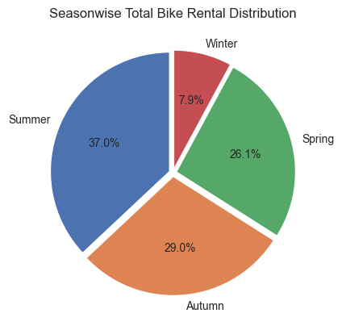
Data analysis
Out of the four seasons in Seoul, summer season experiences the highest demand for bikes, followed by autumn and spring.
Whereas the least bike demand is in the season of winter
From the distribution it is clear that people of Seoul prefer other mode of transport during winter
It is evident from the distribution that the climate plays a significant role in bike rentals

Slide 8
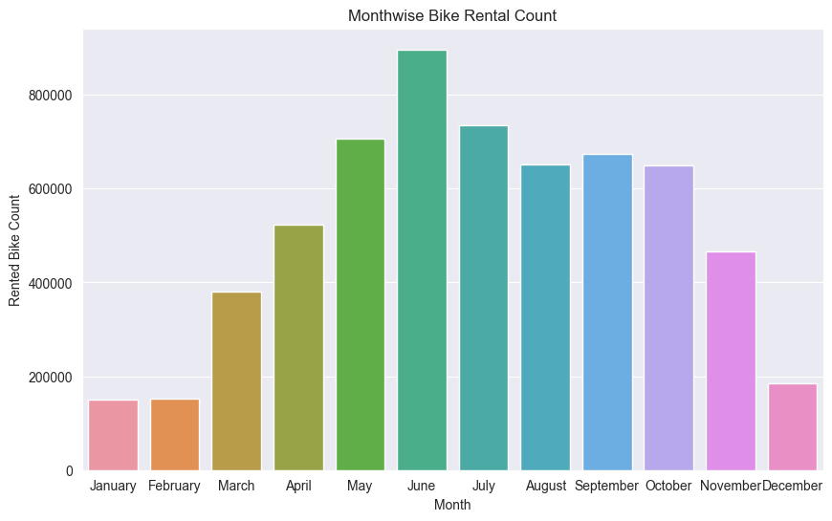
Data analysis
June month experienced the highest demand in the years of 2017 and 2018
Also we can verify the previous analysis where the winters had the least demand from December to February month demand

Slide 9
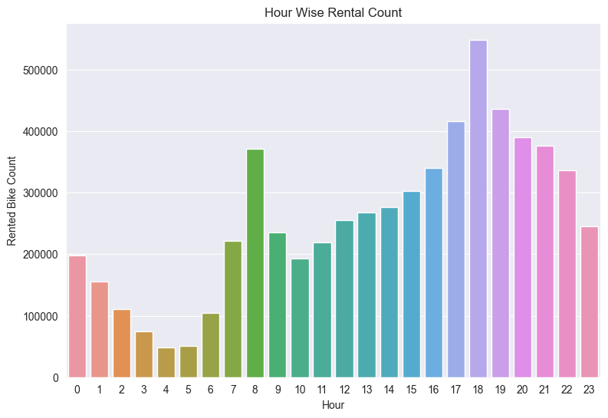
Data analysis
From this analysis, we can infer that people who commute to work use rental bikes for their daily transportation needs.
From this analysis, we can infer that people who commute to work use rental bikes for their daily transportation needs.
Based on the analysis of hourly bike rentals, it has been observed that there is a higher demand for rental bikes during the evening hours
In particular 6 P.M has the highest ever demand in the evening
Meanwhile at 8 A.M has the highest number of bike rentals in the morning
From this analysis we can infer that working professionals use rental bikes for their transportation needs

Slide 10
Data analysis
People tend to rent bikes more frequently on working days over holidays
Also, we can infer that people use rented bikes for commuting to their workplace
In the year 2018 the number of bikes rented out was high when compared to 2017
Holiday | Rented Bike Count
Yes | 215895
No | 5956419
Year | Rented Bike Count
2017 | 185330
2018 | 5986984

Slide 11
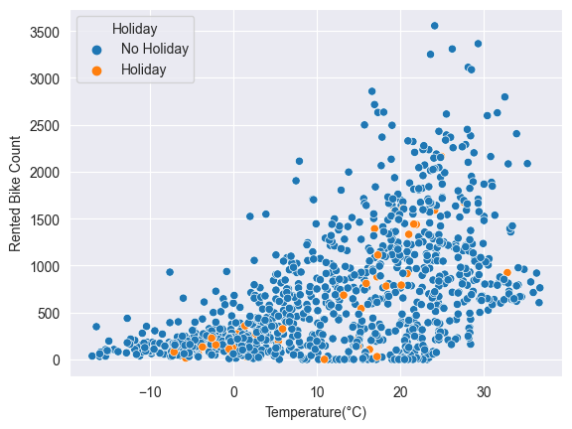
Data analysis
It is evident from the temperature vs rental count graph that Seoul residents prefer to rent bikes during warm weather
On the other hand during cold weather there is a significant drop in the bike rental count
Similarly the dew point temperature also holds the same kind of relationship with the bike rental count

Slide 12
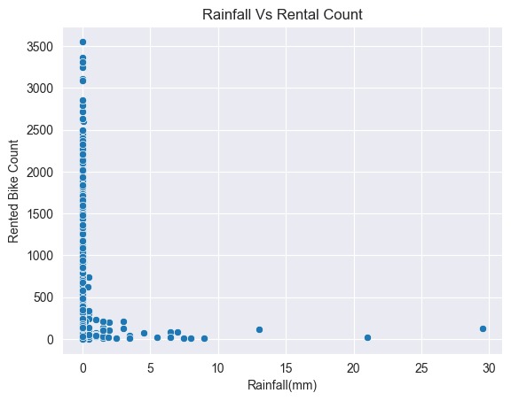
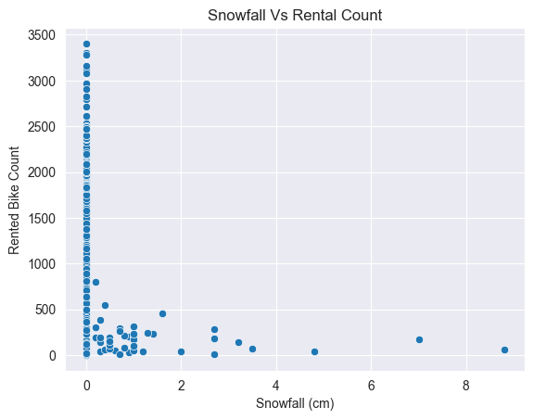
Data analysis
From the two graphs it is clear that Seoul residents prefer to afford a rental bike when there is no rainfall or Snowfall
We can also infer that some people still prefer rental bikes even when there is a small amount of rainfall or snowfall.

Slide 13
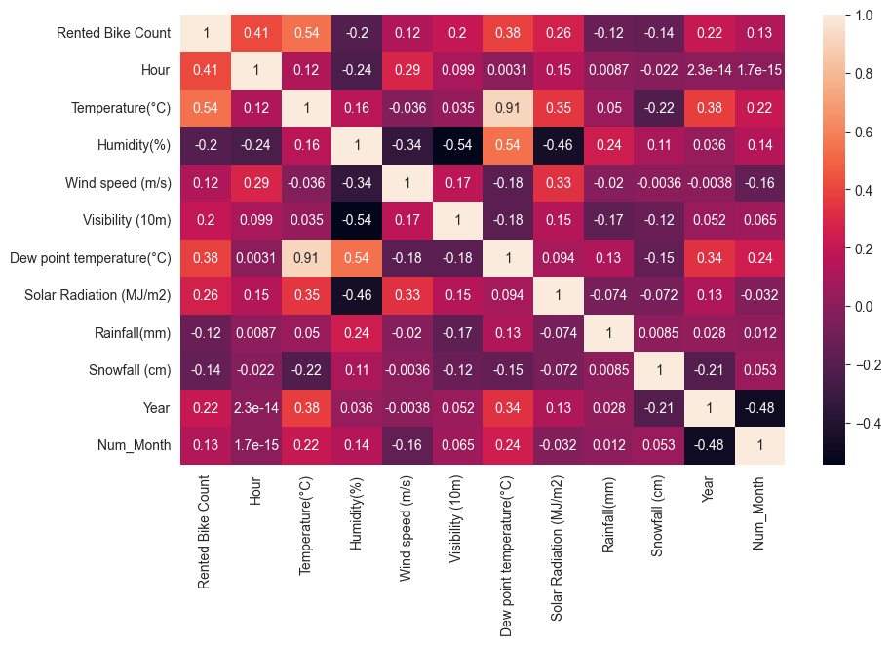
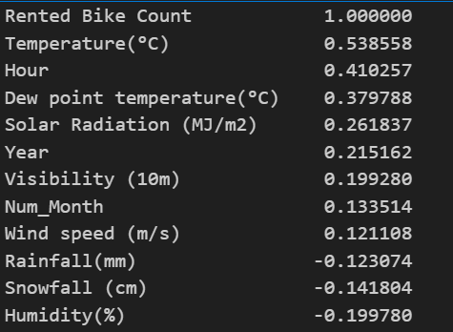
Data analysis
The Linear Correlation between Number of bikes rented and weather conditions are listed below:

Slide 14
Algorithm & Deployment
In the Algorithm section, describe the machine learning algorithm chosen for predicting bike counts. Here's an example structure for this section:
Algorithm Selection:
The XGBoost Regressor is capable of handling both numerical and categorical features, providing flexibility in dealing with diverse types of data present in the bike rental dataset.
Its regularization techniques contribute to stable and reliable predictions, crucial for a regression task with potentially noisy and dynamic data.
Data Input :
For making prediction on number of bike rental per hour on a particular day we use factors like
Season
Month
Weather conditions
Rainy or Snowfall conditions

Slide 15
Algorithm & Deployment
Training Process:
From the cleaned data out of 80% of data is used for training the Machine Learning model
Prediction Process:
Rest 20% of data is used to test the model performance
The performance metrics of model is evaluated with help of mean squared error and r2 score

Slide 16
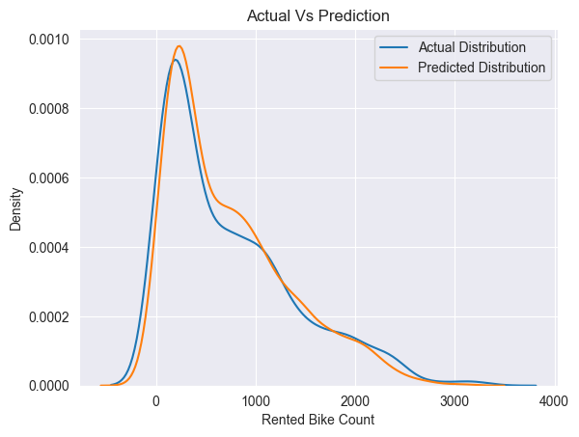
Result
Model: XGB Regressor
Metrics | Values
Mean Squared Error | 75479.3471
R2 Score | 0.8298

Slide 17
Conclusion
The Bike rental company should increase the total number of available bikes during the Summer season as the demand is high
Also the company should focus on bike maintenance and it’s repair in the season of winter so that the company’s reliability goes high
The company may provide rain covers for the riders so that people can prefer the bike rental even during rainy days
New advertising strategies should be followed in the winter season to promote bike rentals
The number of bikes being lent out for rent can be reduced in the winter season so that unwanted maintenance and expense on bikes can be reduced
Based on the feedbacks received from the user the company may adapt new features to promote user experience

Slide 18
References
Dataset: https://www.kaggle.com/datasets/saurabhshahane/seoul-bike-sharing-demand-prediction
Article: https://medium.com/@dancerworld60/project-title-seoul-bike-sharing-demand-prediction-e1be18f23cbe
GItHub:

Slide 19

course certificate 1

Slide 20

course certificate 2

Slide 21
THANK YOU

